Slide 1



November 2025
Power Automate
Microsoft
Benjamin Esquivel
Director of Technology
Imperial Unified School District

Slide 2
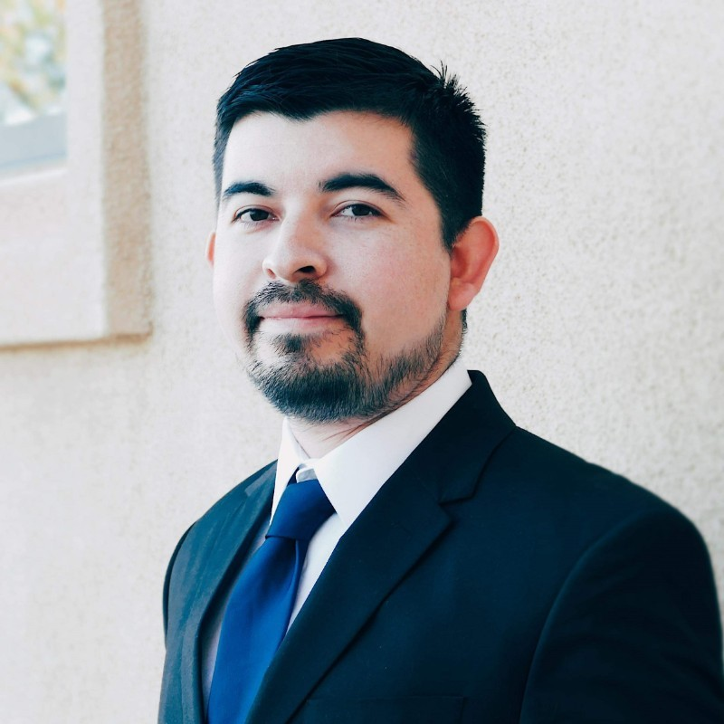

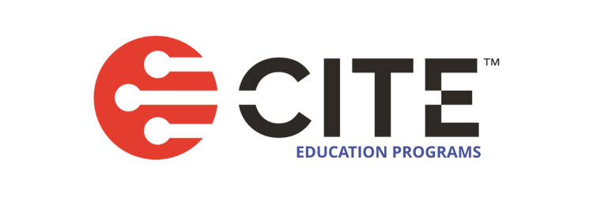
About Me
I’m the Director of Technology at Imperial Unified School District, I’ve spent the past four years leading the technology department with initiatives that support six schools (Elementary, Middle, High, Alt. Ed) and over 4,800 K–12 students.
With an MBA in IT Management and Computer Science background, I’m passionate about using technology to improve learning and operations.
I’m a CITE CTO Mentor Program graduate.

Slide 3
Agenda
4 | Why Power Automate?
5 | Tools & Setup
6 | Automated Workflow Breakdown
7 | Live Demostration
8 | Other Use Cases
9 | Lessons Learned

Slide 4




The Problem
Inefficient and Risky Manual Employee Onboarding
Manual Onboarding
Automated Onboarding
Ticket Submitted
Notify HR
Create Account
Assign Permissions
Notify Supervisor
HR Submits Form
Email Account Info
Notify SIS Admin
1 Step / 1 Person
Back to Agenda
6 Steps / 3 People
Notes:
Before automation, our onboarding process was entirely manual, several steps, multiple people, and a lot of room for human error. On the left you can see our old manual process, this may look more or less similar to some of your setups if you are also manually onboarding. The problems with this manual system fall into three main categories:
First it was incredible inefficient and costly. The 6 steps, 3 people diagram doesn’t show the waiting. The ticket could sit a in a queue for a day. HR might be busy, and by the time a new hire started they were often still scrambling to get their accounts ready for their classes.
Second and this is what kept me up at night, it was a huge security and compliance risk.
"Every manual step is a chance for human error. A busy tech might misspell a name, or worse, give the wrong permissions."
"The flip side is just as bad. We'd forget to add a user to a critical group, and now they can't access the SIS or their Clever applications. We had no reliable audit trail to prove who had access to what, and when.“
And Finally, it was a terrible user experience
"Think about it: we'd have a new teacher, excited for their first day. They sit down at their desk, and... they can't log in. Their computer is a paperweight."
"It makes the new hire feel unsupported, it makes our department look disorganized, and it's a 100% preventable loss of productivity from day one.“
(Point to the “Automated Process” side.)
"So, we had a process that was slow, risky, and frustrating for everyone. We knew we had to fix it. This automated workflow on the right is where we are now. One step. One person. Minutes, not days."

Slide 5


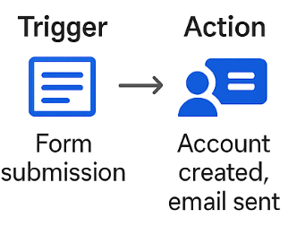


What is Power Automate?
Power Automate is Microsoft’s automation platform that connects apps and services to streamline repetitive tasks
Automates workflows across Microsoft Microsft 365 and third-party apps
Reduces manual and repetitive tasks
Works security with Azure Active Directory (Entra ID) and Microsoft Graph
Scales from small tasks to enterprise workflows
Back to Agenda
Notes:
To get there, we had to find the right tool. And that’s when we started to seriously look at Power Automate…”
Simple Definition: "At its core, Power Automate is Microsoft’s tool for eliminating mouse clicks and manual copy-pasting. We can think of it as a digital worker that you train once to perform any repetitive sequence of tasks perfectly, every single time."
Key Advantage (Integration): "The most critical factor for IUSD is that this tool is native to the Microsoft 365 environment that we already pay for and rely on. It's built to securely talk to Teams, SharePoint, Outlook, and most importantly, Azure Active Directory (Entra ID)."
Security and Control: "The secure connection to Entra ID is vital. It means we aren't using clunky scripts or exposing administrator passwords. We can automate critical identity tasks, like creating a new user or assigning licenses, all within the secure Microsoft ecosystem. That's a huge win for compliance and risk management."
Reiterating the Value: "In short, Power Automate allows us to take a messy, manual, multi-day process and convert it into an instantaneous, secure, single-button workflow. It gives us the ability to scale our IT department's efficiency without scaling our budget."
"Once we knew what Power Automate was, the next question was: why choose it over other options? Let's look at the Tool Comparison."

Slide 6




Why Power Automate?
Google API
Python
Vendor
Power Automate
Great if you only have a Google Workspace Environment
More coding knowledge required (javascript)
Flexible and works with many environments
Coding knowledge required
Installation of third-party tools/software/libraries
Great for compliance and saving time
Can be very expensive and hard to customize to district needs
Integrates with Microsoft 365
Cost-effective
No coding knowledge required, however knowing expressions required
Back to Agenda
Notes:
"Once we knew automation was the answer to our onboarding problem, we had to find the right tool—the one that fit within our budget, our existing infrastructure, and our team's skill set. We looked at the three primary alternatives."
Google API (and other scripting): "If we were purely a Google Workspace environment, this would be a strong option. However, for us, it means writing JavaScript code from scratch to bridge all the systems—it’s high code, it’s brittle, and it requires dedicated development time for maintenance."
Python: "Python is powerful and flexible. But again, it requires coding expertise, the setup can be complex, and we’d have to manage a lot of different libraries and endpoints. It's often overkill for repetitive administrative tasks like this."
Third-Party Vendor Solutions: "These are often fantastic for compliance and ease of use, but the barrier is always the cost and customization. Annual contracts for onboarding can run into the tens of thousands of dollars, and you’re locked into their process, which limits our agility."
(Focus on Power Automate as the winner.)
"Power Automate became the clear choice for Imperial Unified for three reasons, as you can see in the bottom row:"
Cost-Effective Licensing: "We already subscribe to Microsoft 365 A3 and A5 plans. This means the core functionality is already paid for. The incremental cost is tiny compared to a custom vendor."
Deep Integration: "It integrates natively with Microsoft 365 and Azure Active Directory. We aren't building bridges; we're using existing, secure pathways."
Low Code: "It’s a low-code/no-code environment. This allows my existing IT staff to build, manage, and troubleshoot the flows without having to be full-stack developers. It gives us high flexibility without the high coding burden."

Slide 7
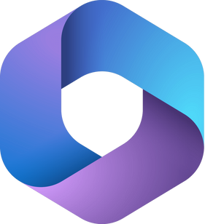




Tools and Setup
License
Power Automate
Premium License
Microsoft 365 A1/A3/A5 plan
Tools
Microsoft Forms
Power Automate
Azure Active Directory
ChatGPT
Back to Agenda
Notes:
"Okay, so we've chosen Power Automate. This slide breaks down the exact recipe we used to build our automated onboarding flow."
(Point to the "License" column.)
"First, the licensing. This is a critical piece."
"We are an M365 A3 and A5 district, which gives us the foundation and all the core apps like Forms and Azure AD."
"The key, however, is the Power Automate Premium License. This is what unlocks the 'premium connectors.' For us, the most important premium connector is the HTTP action. This is what allows Power Automate to securely talk to the Microsoft Graph API, which is the 'language' we use to give commands to Azure Active Directory."
"Without this premium license, we couldn't perform the most critical step: creating the user. The cost of this license is a tiny fraction of a 3rd-party vendor's price."
(Point to the "Tools" column.)
"Next, the tools themselves. Each one has a distinct job:"
"Microsoft Forms: This is our 'trigger' and our front-end. It's the simple, user-friendly interface that HR uses to enter the new employee's information. It's easy, requires no training, and ensures the data is standardized from the start."
"Power Automate: This is the 'engine' or the 'brains' of the operation. It's sitting in the background, listening for that form to be submitted. When it is, the flow wakes up, grabs the data, and starts all the work."
"Azure Active Directory: This is our 'destination.' It's our district's central identity system. This is where Power Automate will securely create the new user account, set their password, and assign them to the correct groups."
"(Optional) ChatGPT: We've also included ChatGPT as a tool because you can integrate it to do things like auto-generate a friendly welcome email body, but the core of our user creation relies on the other three."
(Summarize the slide.)
"So, it's a simple but powerful stack: Forms is the trigger, Power Automate is the engine, and Azure AD is the action."

Slide 8


Solution Overview: Automating the Workflow
HR Submits Form
Power Automate
Create User in Azure ID
Email Account Info
Back to Agenda
Notes:
"This is the whole process, distilled into three high-level steps. This is the efficient, streamlined workflow that replaced the old, risky, six-step manual process."
Step 1: HR Submits Form (The Trigger)
"This is where it all starts. HR enters the new hire's information—their name, their job title, their start date—into a simple Microsoft Form. That's their entire involvement."
"The key here is data standardization. Because they have to fill out specific fields, we eliminate issues like misspellings, incorrect capitalization, or missing information that often plagued the old process."
"The moment they hit 'Submit,' that form data immediately wakes up the flow."
Step 2: Power Automate (The Engine)
"This is the engine running the show. The flow is triggered, and it does all the complicated, invisible work perfectly and securely every time."
"Internally, this is where it executes the 'premium' actions we discussed: it gets a secure access token, it runs any data transformation (like formatting the first name and last name into a standardized username), and it holds all the error checking logic."
"It knows exactly what to do with that data and what systems need to be touched."
Step 3: Action (The Outcome)
"This is the perfect, reliable result we were looking for. The flow connects directly to Azure AD and creates the user account, assigns the proper licenses, and enrolls them into the correct initial groups—all in seconds."
"Then, it generates a polished email with the new credentials and sends it to the HR manager or the employee's direct supervisor. The whole information transfer is automated, secure, and instantaneous."
(Transition to the next slide.)

Slide 9
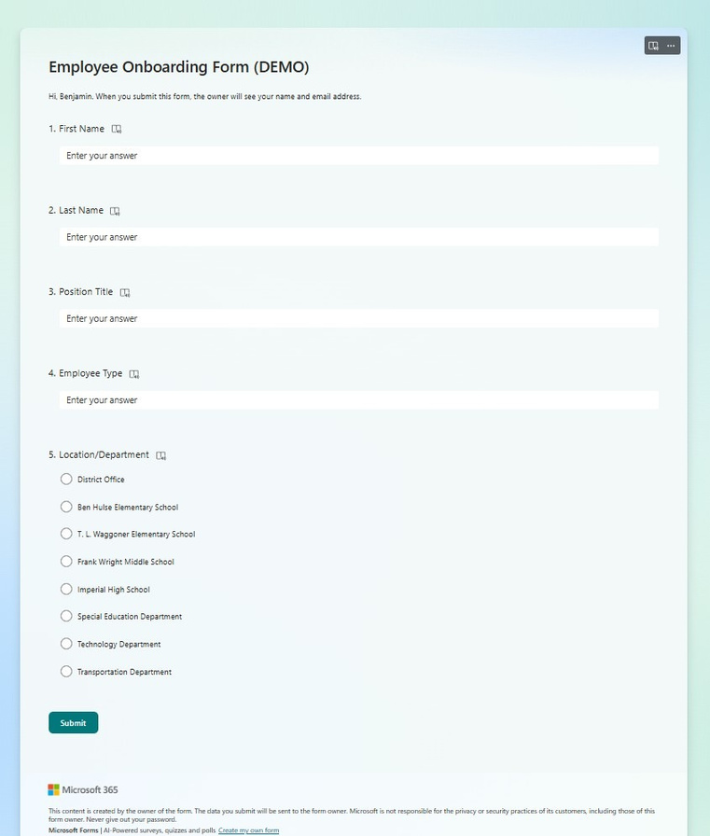
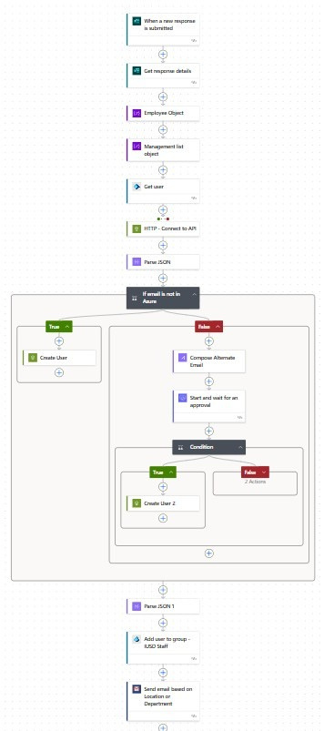
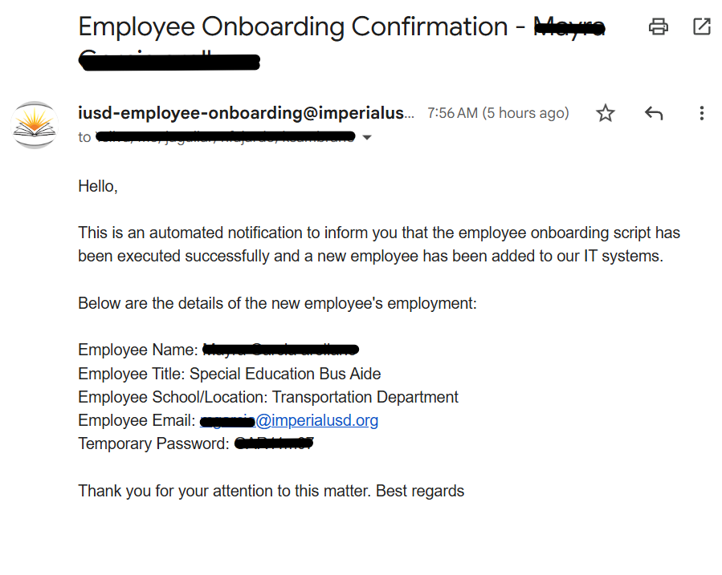
Automated Workflow Breakdown - Onboarding
Notes:
"We've covered the problem, we've reviewed the tools, and we've walked through the blueprint of the workflow. Now, let's see the magic happen. This is the moment we turn that slow, high-risk process into an instantaneous, secure workflow."
(During the Demo Setup, before you click 'Submit'):
"The key to this demo is watching the clock and watching the steps."
"Remember the old process involved multiple steps, a separate ticket, emails, and usually took 1 to 3 days. Our goal is to complete the same administrative task in under 60 seconds."
"On the screen, you see the simple Microsoft Form that HR is using. I’m going to enter a new fictional employee, let's call him 'John Doe,' who is a new teacher starting at one of our schools."
(As you perform the demo, focus the audience on the three points on the slide):
Focus Point 1: The Trigger
"Watch what happens the instant I hit Submit. The flow wakes up instantly and starts working—no more ticket queues, no more waiting."
Focus Point 2: The Actions
"While the flow is running, the Power Automate engine is doing all the heavy lifting you saw in the appendix slides: getting the secure API token, creating the new user object in Azure AD, and setting the group memberships based on their job title."
"This is where all the risk of human error is eliminated, ensuring perfect consistency every time."
Focus Point 3: The Outcome
"And just like that, the flow is complete! The user account is live, the licenses are assigned, and the HR manager has received a formatted email with the new credentials, ready to hand off to the new employee."
"Minutes, not days. That's the real win for IUSD."
(Wrap up the demo.)
"This is one employee, automated. Now multiply that speed, that reliability, and that security across every new hire we bring into the district. It’s transformative."
(Transition to the next slide.)
"Of course, once you build this infrastructure, you start looking around for other tasks to automate. Let's look at a few Other Use Cases at IUSD."

Slide 10
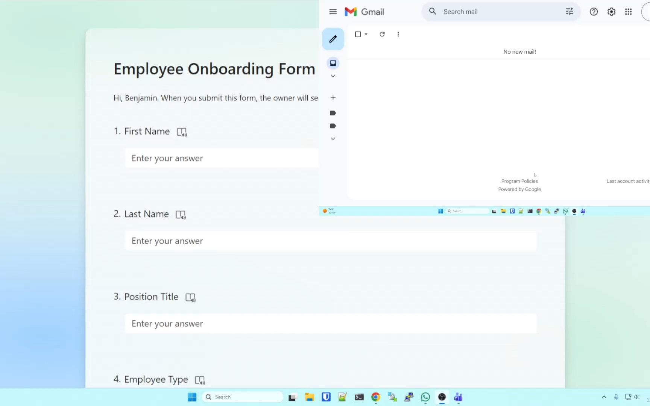
LIVE DEMO
Notes:
"We've covered the problem, we've reviewed the tools, and we've walked through the blueprint of the workflow. Now, let's see the magic happen. This is the moment we turn that slow, high-risk process into an instantaneous, secure workflow."
(During the Demo Setup, before you click 'Submit'):
"The key to this demo is watching the clock and watching the steps."
"Remember the old process involved multiple steps, a separate ticket, emails, and usually took 1 to 3 days. Our goal is to complete the same administrative task in under 60 seconds."
"On the screen, you see the simple Microsoft Form that HR is using. I’m going to enter a new fictional employee, let's call him 'John Doe,' who is a new teacher starting at one of our schools."
(As you perform the demo, focus the audience on the three points on the slide):
Focus Point 1: The Trigger
"Watch what happens the instant I hit Submit. The flow wakes up instantly and starts working—no more ticket queues, no more waiting."
Focus Point 2: The Actions
"While the flow is running, the Power Automate engine is doing all the heavy lifting you saw in the appendix slides: getting the secure API token, creating the new user object in Azure AD, and setting the group memberships based on their job title."
"This is where all the risk of human error is eliminated, ensuring perfect consistency every time."
Focus Point 3: The Outcome
"And just like that, the flow is complete! The user account is live, the licenses are assigned, and the HR manager has received a formatted email with the new credentials, ready to hand off to the new employee."
"Minutes, not days. That's the real win for IUSD."
(Wrap up the demo.)
"This is one employee, automated. Now multiply that speed, that reliability, and that security across every new hire we bring into the district. It’s transformative."
(Transition to the next slide.)
"Of course, once you build this infrastructure, you start looking around for other tasks to automate. Let's look at a few Other Use Cases at IUSD."

Slide 11
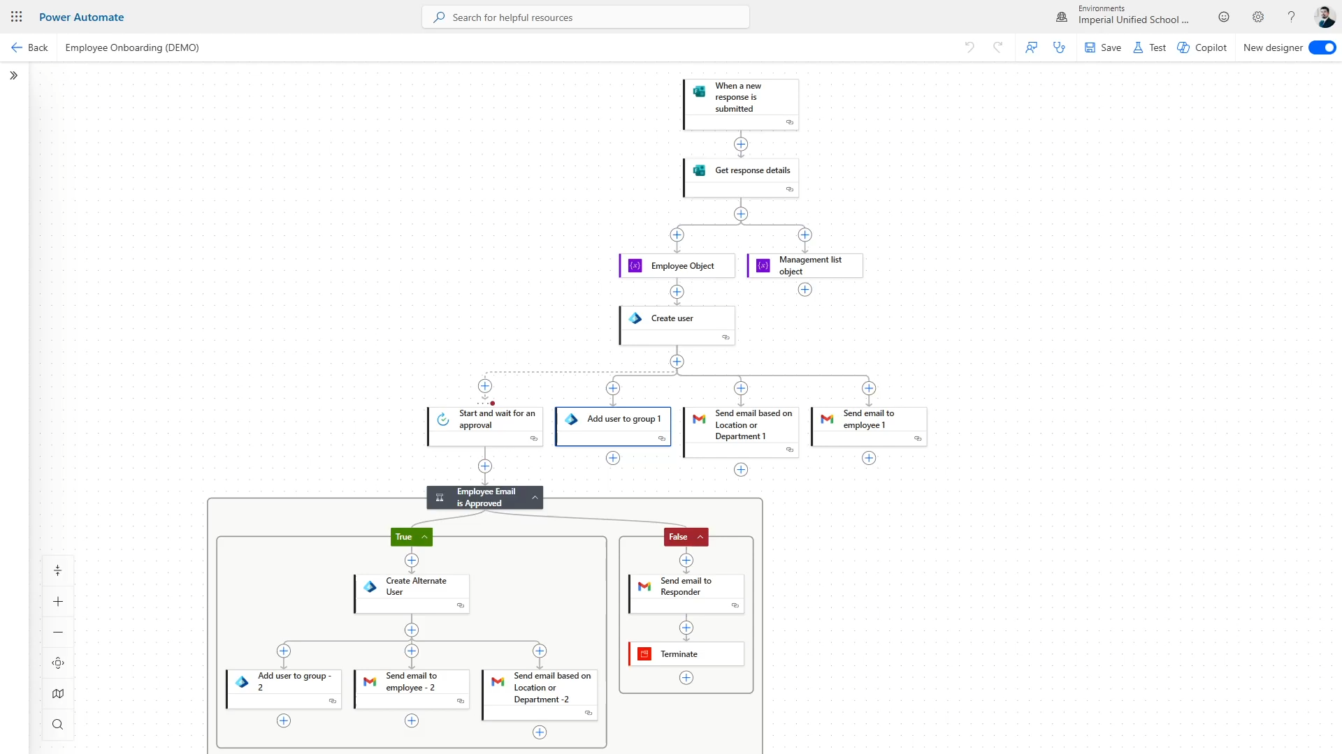
LIVE DEMO
Notes:
"We've covered the problem, we've reviewed the tools, and we've walked through the blueprint of the workflow. Now, let's see the magic happen. This is the moment we turn that slow, high-risk process into an instantaneous, secure workflow."
(During the Demo Setup, before you click 'Submit'):
"The key to this demo is watching the clock and watching the steps."
"Remember the old process involved multiple steps, a separate ticket, emails, and usually took 1 to 3 days. Our goal is to complete the same administrative task in under 60 seconds."
"On the screen, you see the simple Microsoft Form that HR is using. I’m going to enter a new fictional employee, let's call him 'John Doe,' who is a new teacher starting at one of our schools."
(As you perform the demo, focus the audience on the three points on the slide):
Focus Point 1: The Trigger
"Watch what happens the instant I hit Submit. The flow wakes up instantly and starts working—no more ticket queues, no more waiting."
Focus Point 2: The Actions
"While the flow is running, the Power Automate engine is doing all the heavy lifting you saw in the appendix slides: getting the secure API token, creating the new user object in Azure AD, and setting the group memberships based on their job title."
"This is where all the risk of human error is eliminated, ensuring perfect consistency every time."
Focus Point 3: The Outcome
"And just like that, the flow is complete! The user account is live, the licenses are assigned, and the HR manager has received a formatted email with the new credentials, ready to hand off to the new employee."
"Minutes, not days. That's the real win for IUSD."
(Wrap up the demo.)
"This is one employee, automated. Now multiply that speed, that reliability, and that security across every new hire we bring into the district. It’s transformative."
(Transition to the next slide.)
"Of course, once you build this infrastructure, you start looking around for other tasks to automate. Let's look at a few Other Use Cases at IUSD."

Slide 12
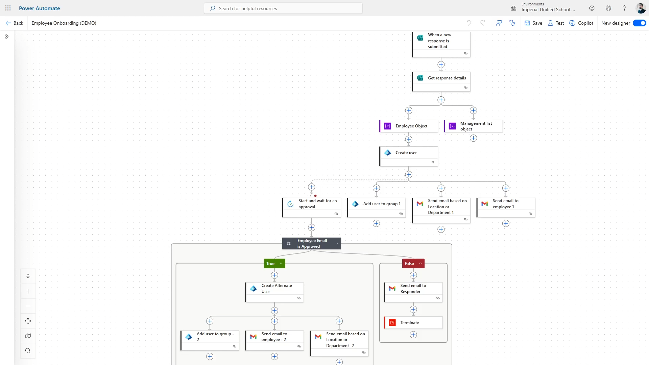
LIVE DEMO
Notes:
"We've covered the problem, we've reviewed the tools, and we've walked through the blueprint of the workflow. Now, let's see the magic happen. This is the moment we turn that slow, high-risk process into an instantaneous, secure workflow."
(During the Demo Setup, before you click 'Submit'):
"The key to this demo is watching the clock and watching the steps."
"Remember the old process involved multiple steps, a separate ticket, emails, and usually took 1 to 3 days. Our goal is to complete the same administrative task in under 60 seconds."
"On the screen, you see the simple Microsoft Form that HR is using. I’m going to enter a new fictional employee, let's call him 'John Doe,' who is a new teacher starting at one of our schools."
(As you perform the demo, focus the audience on the three points on the slide):
Focus Point 1: The Trigger
"Watch what happens the instant I hit Submit. The flow wakes up instantly and starts working—no more ticket queues, no more waiting."
Focus Point 2: The Actions
"While the flow is running, the Power Automate engine is doing all the heavy lifting you saw in the appendix slides: getting the secure API token, creating the new user object in Azure AD, and setting the group memberships based on their job title."
"This is where all the risk of human error is eliminated, ensuring perfect consistency every time."
Focus Point 3: The Outcome
"And just like that, the flow is complete! The user account is live, the licenses are assigned, and the HR manager has received a formatted email with the new credentials, ready to hand off to the new employee."
"Minutes, not days. That's the real win for IUSD."
(Wrap up the demo.)
"This is one employee, automated. Now multiply that speed, that reliability, and that security across every new hire we bring into the district. It’s transformative."
(Transition to the next slide.)
"Of course, once you build this infrastructure, you start looking around for other tasks to automate. Let's look at a few Other Use Cases at IUSD."

Slide 13
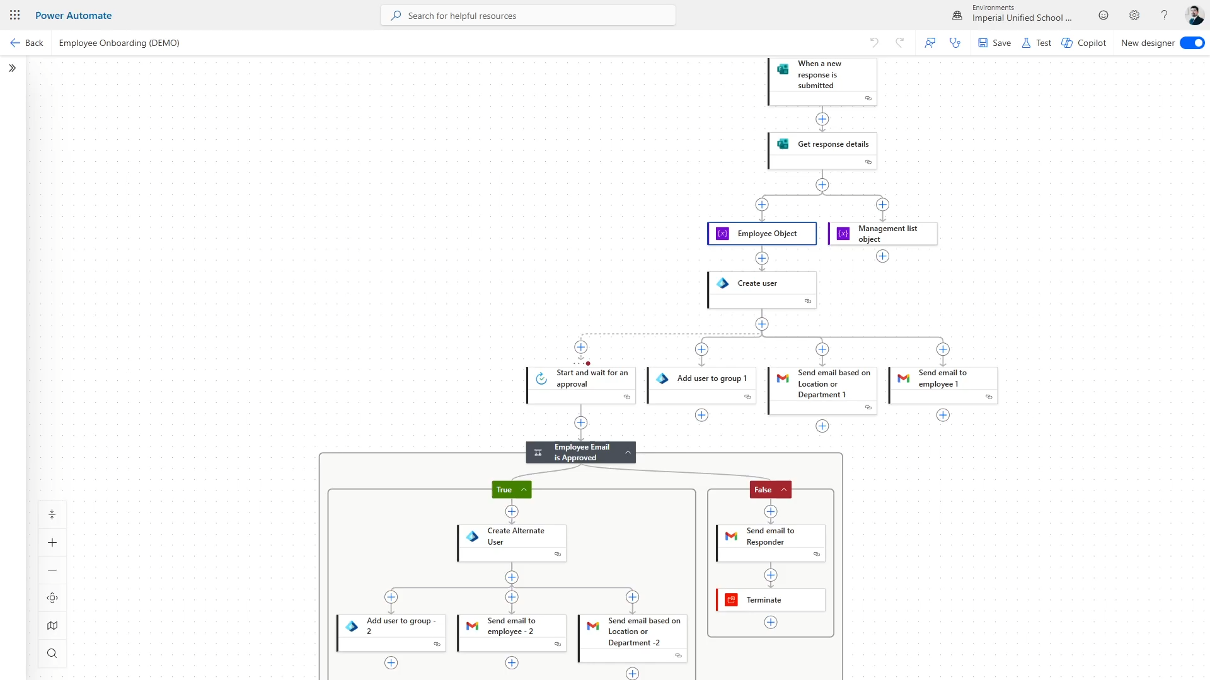
LIVE DEMO
Notes:
"We've covered the problem, we've reviewed the tools, and we've walked through the blueprint of the workflow. Now, let's see the magic happen. This is the moment we turn that slow, high-risk process into an instantaneous, secure workflow."
(During the Demo Setup, before you click 'Submit'):
"The key to this demo is watching the clock and watching the steps."
"Remember the old process involved multiple steps, a separate ticket, emails, and usually took 1 to 3 days. Our goal is to complete the same administrative task in under 60 seconds."
"On the screen, you see the simple Microsoft Form that HR is using. I’m going to enter a new fictional employee, let's call him 'John Doe,' who is a new teacher starting at one of our schools."
(As you perform the demo, focus the audience on the three points on the slide):
Focus Point 1: The Trigger
"Watch what happens the instant I hit Submit. The flow wakes up instantly and starts working—no more ticket queues, no more waiting."
Focus Point 2: The Actions
"While the flow is running, the Power Automate engine is doing all the heavy lifting you saw in the appendix slides: getting the secure API token, creating the new user object in Azure AD, and setting the group memberships based on their job title."
"This is where all the risk of human error is eliminated, ensuring perfect consistency every time."
Focus Point 3: The Outcome
"And just like that, the flow is complete! The user account is live, the licenses are assigned, and the HR manager has received a formatted email with the new credentials, ready to hand off to the new employee."
"Minutes, not days. That's the real win for IUSD."
(Wrap up the demo.)
"This is one employee, automated. Now multiply that speed, that reliability, and that security across every new hire we bring into the district. It’s transformative."
(Transition to the next slide.)
"Of course, once you build this infrastructure, you start looking around for other tasks to automate. Let's look at a few Other Use Cases at IUSD."

Slide 14



Other Uses Cases
Hotspot Request Routing
Checks school selection
Send request to principal or technician
Student Password Requests
Searches Azure AD
Sets temporary password
Device Checkout & Return Tracking
Logs and updates inventory
Notifies librarian or technician
Back to Agenda

Slide 15



Lessons Learned
Start Small
Identify a pilot process to automate in the beginning.
Document Automations
Write down how flows are built, what triggers them, and who owns them.
User Feedback is valuable
Get users’ input to iterate and improve the solution.

Slide 16
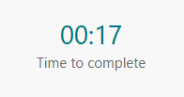
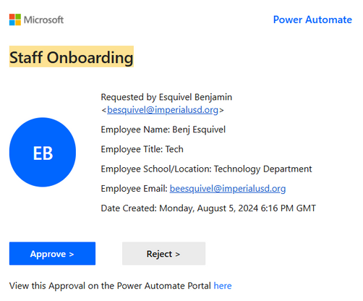
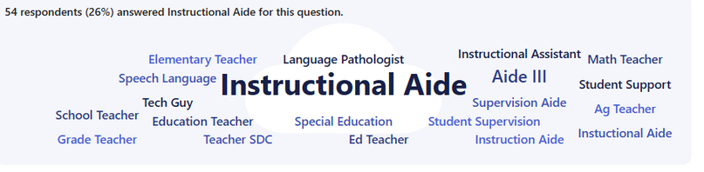
Time Saved
Reduces onboarding time from days to minutes
Error Reduction
Reduces errors such as duplicates emails, misspellings, incorrect cases, etc.
Cost Saving
Thousands of dollars saved from hiring 3rd party
Leadership
Loves Metrics
Scalability

Slide 17

Questions

Slide 18
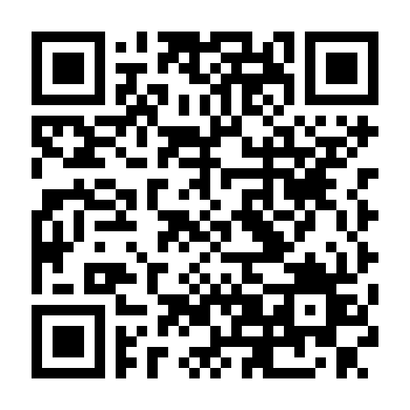
Download the slides & PowerAutomate Flow:
github.com/Silo0268/powerautomate-onboarding-flow

